Slide 1
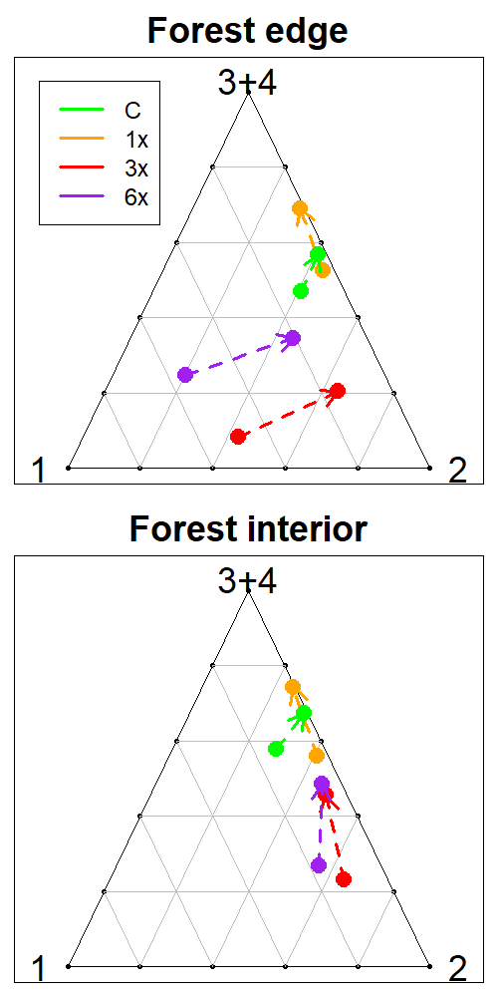
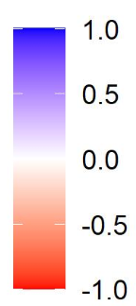




A. Difference maps (2018-2014)
B. Barycentric coordinates

